Slide 1

Cooling Sleeping Pad Using Peltier Module (TEC1-12706)
An Innovative Solution for Comfortable Sleep
Sonia Azhar Siddiqui
Amir Rehman
Abdul Ghani
Arham Jaffer
SEMESTER 3 EE – B2
01

Slide 2

Problem Statement
What is the problem?
A way to cool down a single person sleeping in a room without the need of an AC to cool the entire room.
02

Slide 3
Proposed Solution
What are we doing?
Designing a cooling sleeping pad using a Peltier module (TEC1-12706) to create a thermoelectric cooling system.
Analysis/Prototype
This project involves developing a prototype that utilizes water circulation for effective cooling.
05

Slide 4
Peltier Effect: The Science Behind Cooling
Thermoelectric Principle
Heat Absorption and Release
Efficient Heat Transfer
The Peltier effect occurs when an electric current is passed through two dissimilar conductors, creating a temperature difference between the two junctions.
One side of the Peltier module absorbs heat, while the other side releases it, creating the cooling effect.
The Cooling Pad's design maximizes the Peltier module's efficiency, enabling effective heat transfer and dissipation.
03

Slide 5
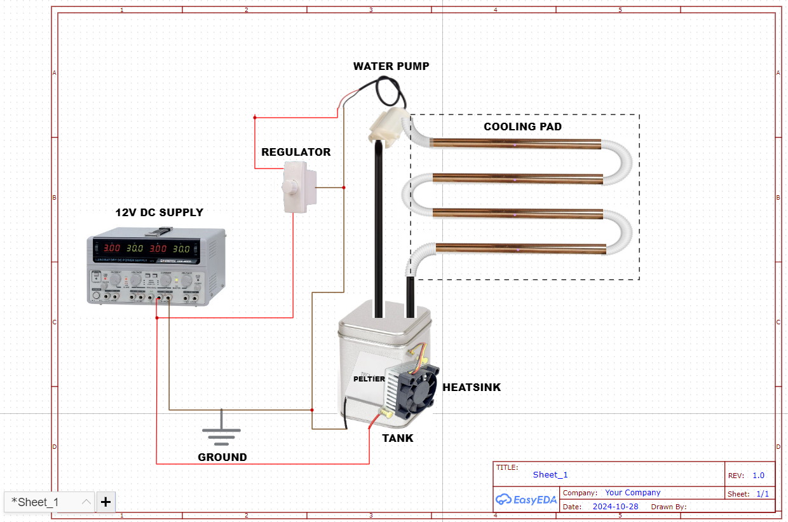
Components and their Roles
07

Slide 6
Link to Report
https://docs.google.com/document/d/1BUxcBxugOwYxlk6tO9YKoJdKB2ELoHtxlpanpZQgNX4/edit?amp;usp=embed_facebook&tab=t.0

